Slide 1

Integers
Understand how computers calculate
Know when computers fail
Understand how computer represent numbers
① Overflow
② Half / full adder
③ Signed / unsigned integers

Slide 2
Perform the following number conversions:
0x39A7F8 to binary
Binary 1100 1001 0111 1011 to hexadecimal
0xD5E4C to binary
Binary 10 0110 1110 0111 1011 0101 to hexadecimal
0011 1001 1010 0111 1111 1000
C 9 7 B
1101 0101 1110 0100 1100
2 6 E 7 B 5

Slide 3
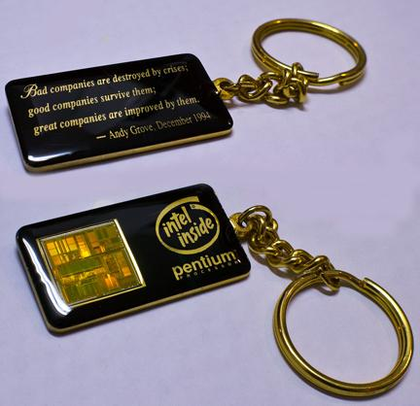
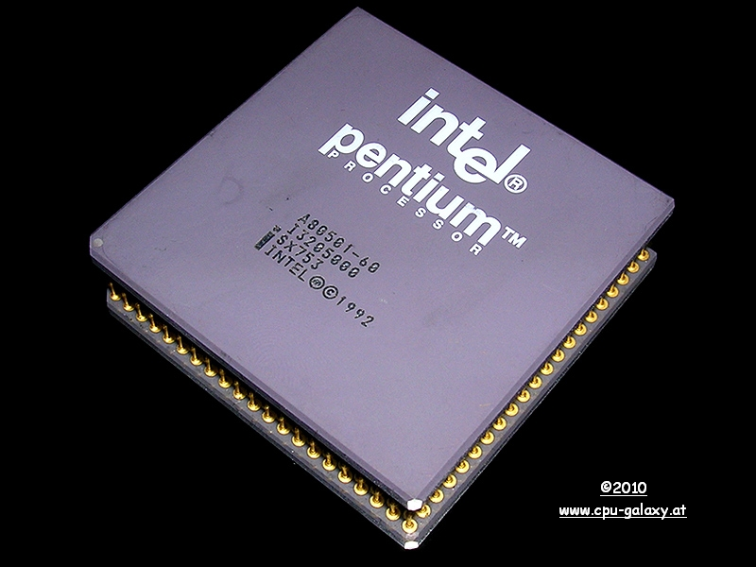
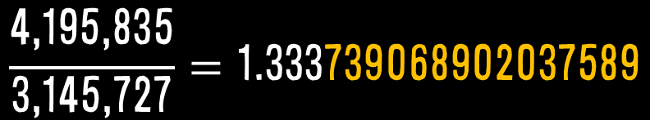
Pentium FDIV bug: $475 million
$$\frac{\text{4,195,835}}{\text{3,145,727}}=\text{1.333}\text{739068902037589}$$

Slide 4
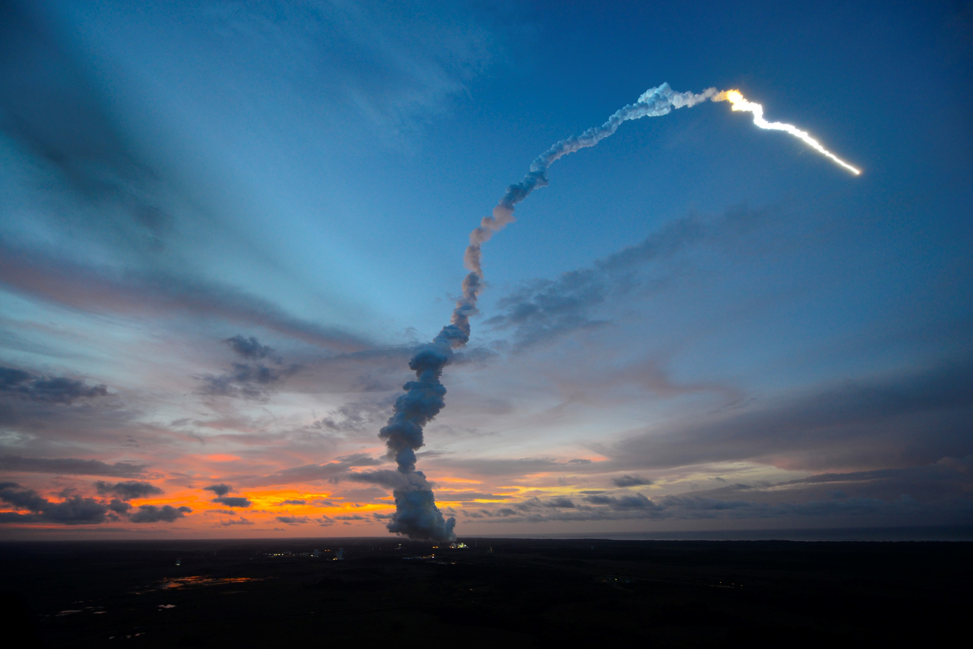
Ariane 5 Overflow bug: $7 billion
Ariane 5 Rocket

Slide 5
Half Adder
0 | + | 0 | = | 00
0 | + | 1 | = | 01
1 | + | 0 | = | 01
1 | + | 1 | = | 10
A | B | Q | C_{OUT}
0 | 0 | 0 | 0
0 | 1 | 1 | 0
1 | 0 | 1 | 0
1 | 1 | 0 | 1
XOR
AND

Slide 6
Full Adder
C_{IN} | A | B | Q | C_{OUT}
0 | 0 | 0 | 0 | 0
0 | 0 | 1 | 1 | 0
0 | 1 | 0 | 1 | 0
0 | 1 | 1 | 0 | 1
1 | 0 | 0 | 1 | 0
1 | 0 | 1 | 0 | 1
1 | 1 | 0 | 0 | 1
1 | 1 | 1 | 1 | 1

Slide 7
Full Adder

Slide 8
N-bit Full Adder
0 1 1 0
0 1 1 1
0
1
1
0
0
1
1
0
1
0 1 1 0
+
0 1 1 1
=
1 1 0 1
6
+
7
=
1 3

Slide 9
Ripple-Carry Adder
Notes:
Carry-Lookahead Adder
Prefix Adder

Slide 10
Arithmetic overflow
1 1 1 0
0 1 1 1
1
1
1
0
0
0
1
0
1
1 1 1 0
+
0 1 1 1
=
0 1 0 1
14
+
7
=
5

Slide 11
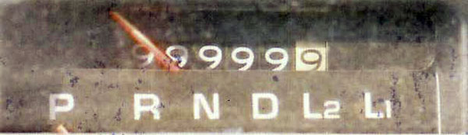
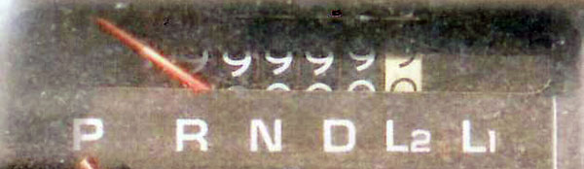
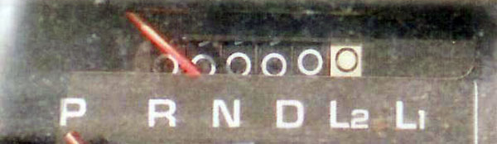

Slide 12
Register width
2005
 | Maximum representable value
8 bits | 2⁸-1 | 255
16 bits | 2¹⁶-1 | 65,535
32 bits | 2³²-1 | 4,294,967,295
64 bits | 2⁶⁴-1 | 18,446,744,073,709,551,615
128 bits | 2¹²⁸-1 | 340 billion billion billion billion
 | Maximum representable value
8 bits | 2⁸-1 | 255
 | Maximum representable value
8 bits | 2⁸-1 | 255
16 bits | 2¹⁶-1 | 65,535
 | Maximum representable value
8 bits | 2⁸-1 | 255
16 bits | 2¹⁶-1 | 65,535
32 bits | 2³²-1 | 4,294,967,295
 | Maximum representable value
8 bits | 2⁸-1 | 255
16 bits | 2¹⁶-1 | 65,535
32 bits | 2³²-1 | 4,294,967,295
64 bits | 2⁶⁴-1 | 18,446,744,073,709,551,615
 | Maximum representable value
8 bits | 2⁸-1 | 255
16 bits | 2¹⁶-1 | 65,535
32 bits | 2³²-1 | 4,294,967,295
64 bits | 2⁶⁴-1 | 18,446,744,073,709,551,615
128 bits | 2¹²⁸-1 | 340 billion billion billion billion
2012

Slide 13
Negative numbers?
7
-7
0
-
1
1
1
1
Sign
-and-
Magnitude
0x00 =
0x7F =
0x85 =
0x80 =
0x00 = | 0 0 0 0 0 0 0 0₂ | is non-negative, because the sign bit is 0
0x7F = | 0 1 1 1 1 1 1 1₂ | is non-negative
0x85 = | 1 0 0 0 0 1 0 1₂ | is negative
0x80 = | 1 0 0 0 0 0 0 0₂ | is negative
0x00 = | 0 0 0 0 0 0 0 0₂ | is non-negative, because the sign bit is 0
0x7F = | 0 1 1 1 1 1 1 1₂ | is non-negative
0x85 = | 1 0 0 0 0 1 0 1₂ | is negative
0x80 = | 1 0 0 0 0 0 0 0₂ | is negative
8 bits

Slide 14
Binary |  |  |  | Decimal
0 | 0 | 0 | 0 | +0
0 | 0 | 0 | 1 | +1
0 | 0 | 1 | 0 | +2
0 | 0 | 1 | 1 | +3
0 | 1 | 0 | 0 | +4
0 | 1 | 0 | 1 | +5
0 | 1 | 1 | 0 | +6
0 | 1 | 1 | 1 | +7
1 | 0 | 0 | 0 | -0
1 | 0 | 0 | 1 | -1
1 | 0 | 1 | 0 | -2
1 | 0 | 1 | 1 | -3
1 | 1 | 0 | 0 | -4
1 | 1 | 0 | 1 | -5
1 | 1 | 1 | 0 | -6
1 | 1 | 1 | 1 | -7
 | 0 | 1 | 0 | 0 |  | 4
+ | 1 | 0 | 1 | 1 | + | -3
 | 1 | 1 | 1 | 1 |  | -7
math is cumbersome

Slide 15
Binary |  |  |  | Decimal
0 | 0 | 0 | 0 | 0
0 | 0 | 0 | 1 | +1
0 | 0 | 1 | 0 | +2
0 | 0 | 1 | 1 | +3
0 | 1 | 0 | 0 | +4
0 | 1 | 0 | 1 | +5
0 | 1 | 1 | 0 | +6
0 | 1 | 1 | 1 | +7
1 | 0 | 0 | 0 | -8
1 | 0 | 0 | 1 | -7
1 | 0 | 1 | 0 | -6
1 | 0 | 1 | 1 | -5
1 | 1 | 0 | 0 | -4
1 | 1 | 0 | 1 | -3
1 | 1 | 1 | 0 | -2
1 | 1 | 1 | 1 | -1
 | 0 | 1 | 0 | 0 |  | 4
+ | 1 | 1 | 0 | 1 | + | -3
 | 0 | 0 | 0 | 1 |  | 1

Slide 16
Two’s Complement
 | 0 | 0 | 0 | 0 | 0 | 0 | 0 | 1 |  | 1
+ | 1 | 1 | 1 | 1 | 1 | 1 | 1 | 1 | + | -1
1 | 0 | 0 | 0 | 0 | 0 | 0 | 0 | 0 | = | 0
 | 0 | 0 | 0 | 0 | 0 | 0 | 0 | 1 |  | 1
+ | ? | ? | ? | ? | ? | ? | ? | ? | + | ?
 | 0 | 0 | 0 | 0 | 0 | 0 | 0 | 0 | = | 0
 | 0 | 0 | 0 | 0 | 0 | 0 | 1 | 0 |  | 2
+ | 1 | 1 | 1 | 1 | 1 | 1 | 1 | 0 | + | -2
1 | 0 | 0 | 0 | 0 | 0 | 0 | 0 | 0 | = | 0
8 bits
 | 0 | 0 | 0 | 0 | 0 | 0 | 1 | 0 |  | 2
+ | ? | ? | ? | ? | ? | ? | ? | ? | + | ?
 | 0 | 0 | 0 | 0 | 0 | 0 | 0 | 0 | = | 0
 | 0 | 0 | 0 | 0 | 0 | 0 | 1 | 1 |  | 3
+ | ? | ? | ? | ? | ? | ? | ? | ? | + | ?
 | 0 | 0 | 0 | 0 | 0 | 0 | 0 | 0 | = | 0
 | 0 | 0 | 0 | 0 | 0 | 0 | 1 | 1 |  | 3
+ | 1 | 1 | 1 | 1 | 1 | 1 | 0 | 1 | + | -3
1 | 0 | 0 | 0 | 0 | 0 | 0 | 0 | 0 | = | 0

Slide 17
Two’s Complement Negatives
MSB have same value, but negative weight
1 | 0 | 1 | 0
-1*2³ + 0*2² + 1*2¹ + 0*2⁰ = -6₁₀
0 | 0 | 1 | 0
-0*2³ + 0*2² + 1*2¹ + 0*2⁰ = 2₁₀
1 | 1 | 1 | 0
-1*2³ + 1*2² + 1*2¹ + 0*2⁰ = -2₁₀
0x00 =
0x7F =
0x85 =
0x80 =
0x00 = | 0 0 0 0 0 0 0 0₂ | 0
0x7F = | 0 1 1 1 1 1 1 1₂ | 127
0x85 = | 1 0 0 0 0 1 0 1₂ | -123
0x80 = | 1 0 0 0 0 0 0 0₂ | -128
~x + 1 = -x
8 bits
one’s complement
two’s complement

Slide 18
C data type | No. of bit | Minimum | Maximum
char | 8 | -128 | 127
unsigned char | 8 | 0 | 255
short | 16 | -32,768 | 32,767
unsigned short | 16 | 0 | 65,535
int | 32 | -2.147 Billion | 2.147 Billion
unsigned | 32 | 0 | 4.295 Billion
long | 64 | -9.2 Quintillion | 9.2 Quintillion
unsigned long | 64 | 0 | 18.4 Quintillion
long long | 64 | -9.2 Quintillion | 9.2 Quintillion
unsigned long long | 64 | 0 | 18.4 Quintillion

Slide 19
1 | 1 | 1 | 1 | 1 | 1 | 1 | 1
Bits are unchanged, just interpreted differently!
If you mix unsigned and signed in a single expression, then signed values implicitly cast to unsigned
Constant₁ | Constant₂ | Relation | Evaluation
0 | 0U | == | unsigned
-1 | 0 | < | signed
-1 | 0U | > | unsigned
2,147,483,647 | -2,147,483,648 | > | signed
2,147,483,647U | -2,147,483,648 | < | unsigned
-1 | -2 | > | signed
(unsigned) -1 | -2 | > | unsigned
2,147,483,647 | 2,147,483,648U | < | unsigned
2,147,483,647 | (int) 2,147,483,648U | > | signed

Slide 20
Sign Extension
Task:
Given w-bit signed integer x,
convert it to w+k-bit integer with same value
Rule: Make k copies of sign bit:
w
X
• • •
• • •
X ′
• • •
• • •
k
w

Slide 21
Sign Extension Example
Converting from smaller to larger integer data type
C automatically performs sign extension
short int x = 12345;
int ix = (int)x;
short int y = -12345;
int iy = (int)y;
x | Decimal | Hex | Binary
x | 12345 | 30 39 | 00110000 01101001
ix | 12345 | 00 00 30 39 | 00000000 00000000 00110000 01101101
y | -12345 | CF C7 | 11001111 11000111
iy | -12345 | FF FF CF C7 | 11111111 11111111 11001111 11000111

Slide 22
short int v = -12345;
unsigned short uv = (unsigned short)v;
printf("v = %d, uv = %u\n", v, uv);
-12345
53191
v = -2¹⁵ + X
uv = 2¹⁵ + X
= 2¹⁵ + v - (-2¹⁵)
= v + 2¹⁶
1
?
?
?
…
-2¹⁵
X
2¹⁵

Slide 23
Two’s Complement
Unsigned

Slide 24
Overflow
exceed the range of the representation
x+y
Positive Overflow
Negative Overflow
Underflow?

Slide 25
Summary
Signed / Unsigned integers
Adder
Overflow

Slide 26

There are 10 kinds of people in this world:
those who can count in binary and those who can’t.
Notes:
Some interesting facts about what these various-sized bytes can store: 1 bit: a binary decision 1 byte: a character 5 Megabytes: The complete works of Shakespeare 2 Gigabytes: 20 meters of shelved books 10 Terabytes: The printed collection of the US Library of Congress 200 Petabytes: All printed material in the whole word. 5 Exabytes: All words ever spoken by human beings
The most commonly accepted explanation is that our base-10 number system was adopted by our ancestors most likely because we have 10 fingers. Interestingly enough, maybe that is why digit in English also means a finger or toe.

